Slide 1
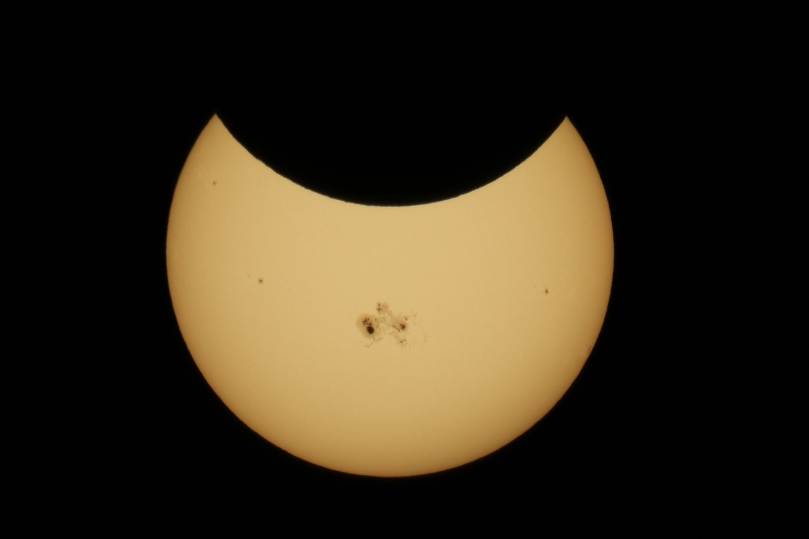
Astronomy C1

Slide 2
Section 1 Astronomy: The Original Science
Chapter J1
Objectives
List the planets in the order in which they orbit the sun.
Explain how scientists measure distances in space.
Describe how the planets in our solar system were discovered.
Describe three ways in which the inner planets and outer planets differ.

Slide 3
Section 1 Astronomy: The Original Science
Chapter J1
Astronomy
People in ancient cultures used the seasonal cycles to determine when they should plant and harvest crops. They built observatories to study the night sky.
Over time, the science of astronomy developed. Astronomy is the study of the universe.

Slide 4
Section 1 Astronomy: The Original Science
Chapter J1
Our Modern Calendar
What Is Our Calendar Based On? The years, months, and days of our modern calendar are based on the observation of bodies in our solar system.

Slide 5
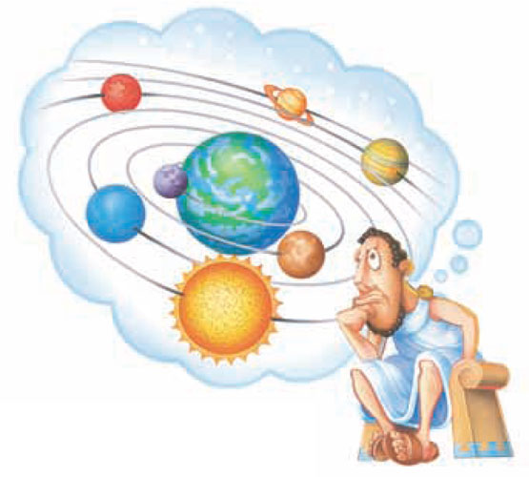
Section 1 Astronomy: The Original Science
Chapter J1
Who’s Who of Early Astronomy
Ptolemy: An Earth-Centered Universe Ptolemy thought that the Earth was at the center of the universe and that the other planets and the sun revolved around the Earth.

Slide 6
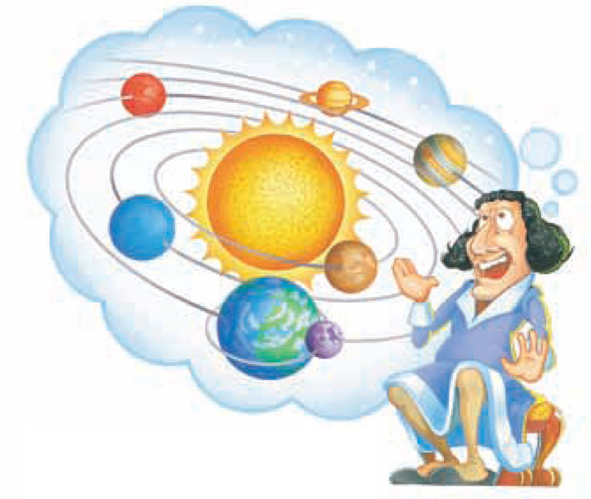
Section 1 Astronomy: The Original Science
Chapter J1
Who’s Who of Early Astronomy
Copernicus: A Sun-Centered Universe Copernicus thought the sun is at the center of the universe, and all of the planets—including the Earth—orbit the sun.

Slide 7
Section 1 Astronomy: The Original Science
Chapter J1
Who’s Who of Early Astronomy, continued
Tycho Brahe: A Wealth of Data In the late-1500s, Danish astronomer Tycho Brahe made the most detailed astronomical observations that had ever been recorded.
Johannes Kepler: Laws of Planetary Motion Johannes Kepler stated three laws of planetary motion. These laws are still used today.

Slide 8
Section 1 Astronomy: The Original Science
Chapter J1
Modern Astronomy
Milestones in Modern Astronomy The invention of the telescope and the discovery of gravity were two milestones in the development of modern astronomy.
Edwin Hubble: Beyond the Edge of the Milky Way In 1924, Edwin Hubble proved that other galaxies existed beyond the edge of the Milky Way.

Slide 9
Chapter J1
Section 2 Telescopes
Bellringer
Have you ever bent or slowed down light? Explain how.
Record your answer in your science journal.

Slide 10
Chapter J1
Section 2 Telescopes
Objectives
Compare refracting telescopes with reflecting telescopes.
Explain how the atmosphere limits astronomical observations, and explain how astronomers overcome these limitations.
List the types of electromagnetic radiation that astronomers use to study objects in space.

Slide 11
Chapter J1
Section 2 Telescopes
Telescopes
A Telescope is an instrument that gathers electromagnetic radiation from objects in space and concentrates it for better observation.
There are many different types of telescopes.

Slide 12
Chapter J1
Section 2 Telescopes
Optical Telescopes
Refracting Telescopes Telescopes that use lenses to gather and focus light are called refracting telescopes. A refracting telescope is shown on the next slide.
Reflecting Telescope A telescope that uses a curved mirror to gather and focus light is called a reflecting telescope. A reflecting telescope is shown on the next slide.

Slide 13
Chapter J1
Section 2 Telescopes
Optical Telescopes
Refracting Telescopes Telescopes that use lenses to gather and focus light are called refracting telescopes. A refracting telescope is shown on the next slide.
Reflecting Telescope A telescope that uses a curved mirror to gather and focus light is called a reflecting telescope. A reflecting telescope is shown on the next slide.

Slide 14
Chapter J1
Section 2 Telescopes
Refracting and Reflecting Telescopes

Slide 15
Chapter J1
Section 2 Telescopes
Optical Telescopes, continued
Very Large Reflecting Telescopes In some very large reflecting telescopes, several mirrors work together to collect light and focus it in the same area.

Slide 16
Chapter J1
Section 2 Telescopes
Optical Telescopes, continued
Optical Telescopes and the Atmosphere The light gathered by telescopes on the Earth is affected by the atmosphere.
Optical Telescopes in Space To avoid interference by the atmosphere, scientists have put telescopes in space

Slide 17
Chapter J1
Section 2 Telescopes
The Electromagnetic Spectrum
What Is the Electromagnetic Spectrum? The electromagnetic spectrum is made up of all of the wavelengths of electromagnetic radiation.
Detecting Electromagnetic Radiation Visible light is only a small band of the electromagnetic spectrum. Radio waves, microwaves, infrared light, ultraviolet light, X rays, and gamma rays— are invisible to the human eye.

Slide 18
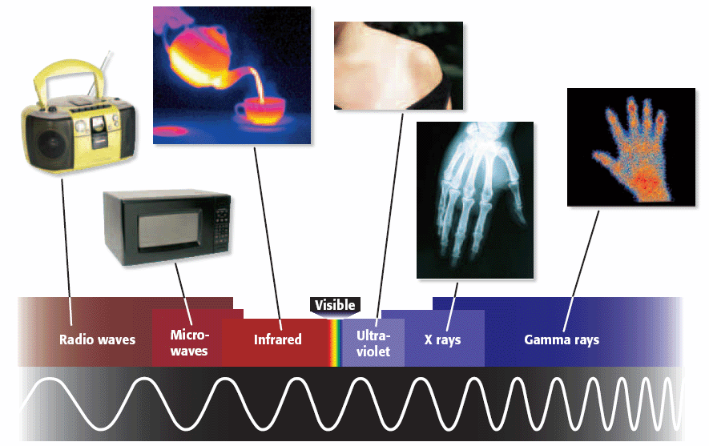
Chapter J1
Section 2 Telescopes
The Electromagnetic Spectrum

Slide 19
Chapter J1
Section 2 Telescopes
Nonoptical Telescopes
Radio Telescopes Radio telescopes detect radio waves. Because radio wavelengths are much larger than optical wavelengths, radio telescopes much be very large.
Linking Radio Telescopes Astronomers can get more detailed images of the universe by linking radio telescopes together. Working together, the telescopes function as a single giant telescope.

Slide 20
Chapter J1
Section 2 Telescopes
Nonoptical Telescopes, continued
Nonoptical Telescopes in Space Because most electromagnetic waves are blocked by the Earth’s atmosphere, scientists have placed ultraviolet telescopes, infrared telescopes, gamma-ray telescopes, and X-ray telescopes in space.

Slide 21
Chapter J1
Section 3 Mapping the Stars
Bellringer
Is it possible to determine the direction of the North Pole just by looking at the stars? Explain your answer.
Write your answer in your science journal.
.

Slide 22
Chapter J1
Section 3 Mapping the Stars
Objectives
Explain how constellations are used to organize the night sky.
Describe how the altitude of a star is measured.
Explain how the celestial sphere is used to describe the location of objects in the sky.
Compare size and scale in the universe, and explain how red shift indicates that the universe is expanding.

Slide 23
Chapter J1
Section 3 Mapping the Stars
Patterns in the Sky
Constellations Help Organize the Sky A constellation is a region of the sky. Each constellation shares a border with neighboring constellations. A constellation map is shown on the next slide.
Seasonal Changes As Earth revolves around the sun, the apparent locations of the constellations change from season to season.

Slide 24
Chapter J1
Section 3 Mapping the Stars
Spring Constellations in the Northern Hemisphere

Slide 25
Chapter J1
Section 3 Mapping the Stars
Finding Stars in the Night Sky
You can describe the location of a star or planet by using an instrument called an astrolabe and the following points of reference:
The zenith is the point in the sky directly above on observer on Earth.
The altitude is the angle between an object in the sky and the horizon.
The horizon is the line where the sky and the Earth appear to meet.

Slide 26
Chapter J1
Section 3 Mapping the Stars
Zenith, Altitude, and Horizon

Slide 27
Chapter J1
Section 3 Mapping the Stars
Finding Stars in the Night Sky, continued
Using an astrolabe allows you to describe where a star or planet is relative to you. Scientists need a different method that describes location independently of the observer’s location.
Astronomers describe the location of a star or planet in terms of the celestial sphere.

Slide 28
Chapter J1
Section 3 Mapping the Stars
The Celestial Sphere

Slide 29
Chapter J1
Section 3 Mapping the Stars
Describing a Star’s Position
Click below to watch the Visual Concept.
You may stop the video at any time by pressing the Esc key.
Visual Concept

Slide 30
Chapter J1
Section 3 Mapping the Stars
The Size and Scale of the Universe
In the 1600s, Nicolaus Copernicus noticed that the planets appeared to move relative to each other but that the stars did not. Thus, he thought that the stars must be much farther away than the planets.
Measuring Distance in Space A light-year is a unit of length equal to the distance that light travels in 1 year.

Slide 31
Chapter J1
Section 3 Mapping the Stars
The Size and Scale of the Universe, continued
It is important to consider scale when thinking about the universe. Although stars looks tiny in the night sky, remember that they are actually a lot larger than Earth.

Slide 32
Chapter J1
Section 3 Mapping the Stars
The Doppler Effect
What Is the Doppler Effect? Have you ever noticed that when a driver in an approaching car blows the horn, the horn sounds higher pitched as the car approaches and lower pitched after the car passes? This effect is called the Doppler effect.
An Expanding Universe The Doppler effect has been used to discover that galaxies are rapidly moving apart from each other.

Slide 33
Chapter J1
Section 3 Mapping the Stars
Red Shift
Click below to watch the Visual Concept.
You may stop the video at any time by pressing the Esc key.
Visual Concept

Slide 34
Chapter J1
Studying Space
Concept Map
Use the terms below to complete the concept map on the next slide.
declination zenith equator horizon | celestial objects altitude celestial equator astronomy

Slide 35
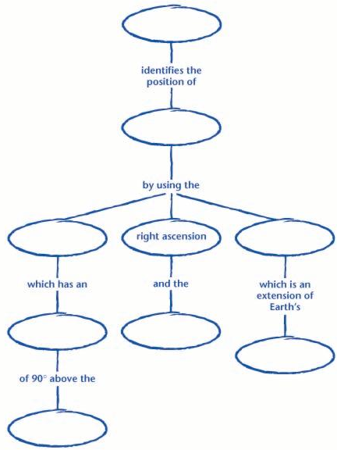
Chapter J1
Studying Space

Slide 36
Chapter J1
Studying Space

